Slide 1






Course: Software Engineering
Project presentation
Gruppo 17:
Luigi Corvino
ALexander De Santis
Alfonso Esposito
a.a 2021/2022

Slide 2


Tools
PRE-GAME PHASE
GitHub repo: https://github.com/luigicorvino/ProgrammableCalculator
Trello: https://trello.com/b/tsxGBUc8/programmablecalculator
Programming language: Java 8
IDE: NetBeans 8.2
External Libraries: Apache Commons Math 3.6.1
https://commons.apache.org/proper/commons-math/

Slide 3
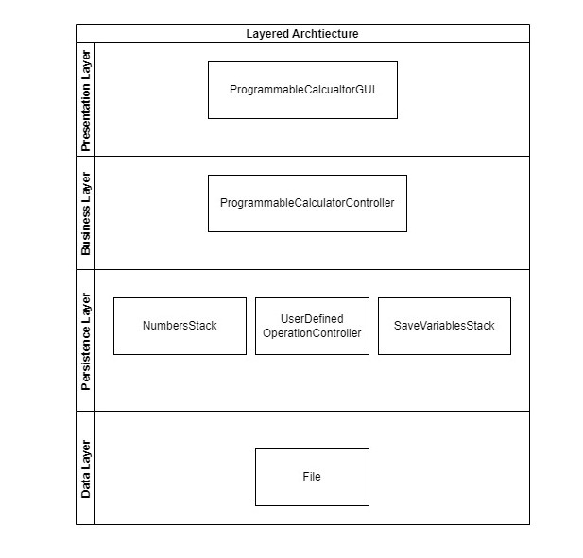
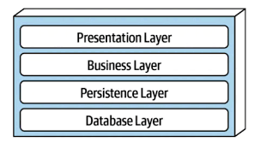
Software Architecture
Layered Style
Components communicate with the other components in the layers immediately above and below their layer

Slide 4
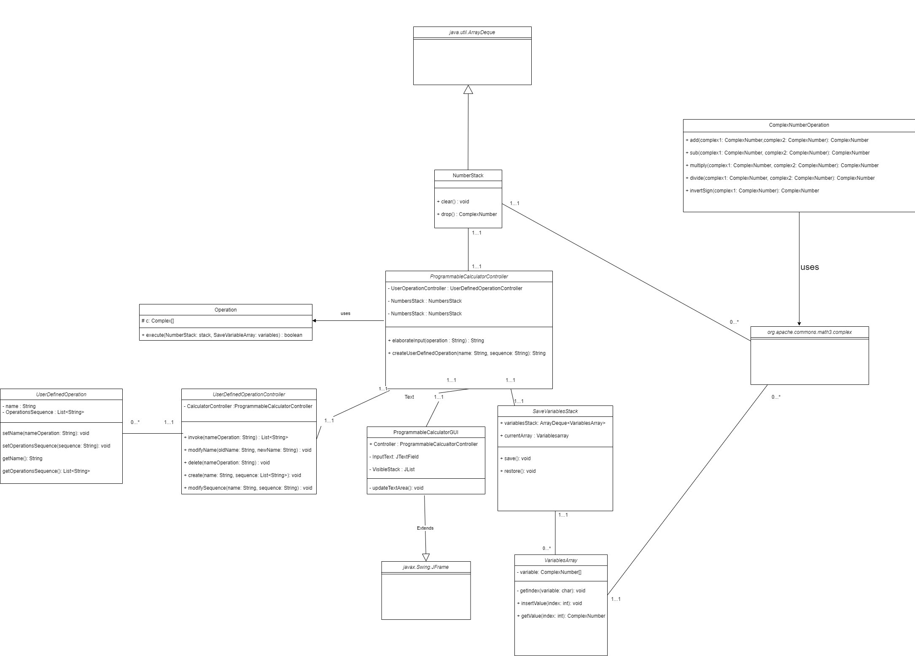

Slide 5
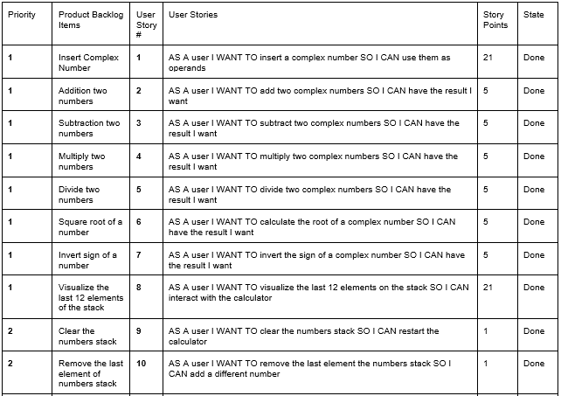
Product Backlog

Slide 6
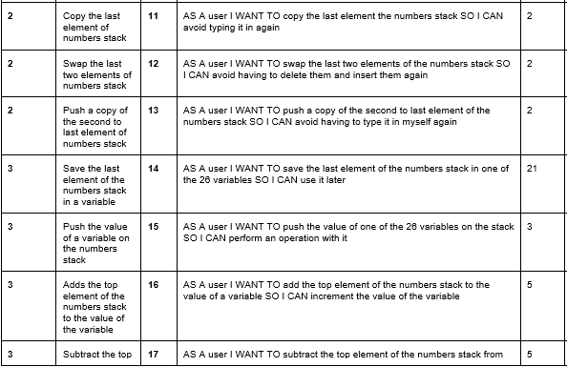
Product Backlog

Slide 7
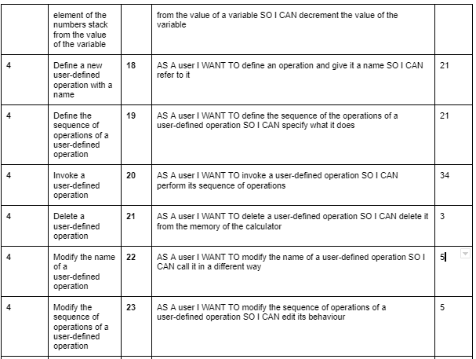
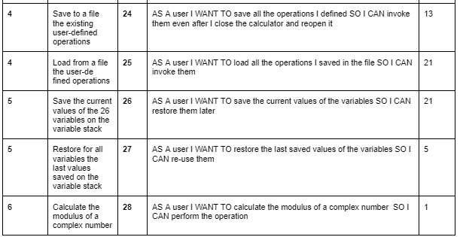
Product Backlog

Slide 8


Velocity First Sprint
Total Story Points Remaining: 264
Estimated Velocity for the first Sprint: 51 Story Points
1 Story Point = 20 min of work of one developer

Slide 9
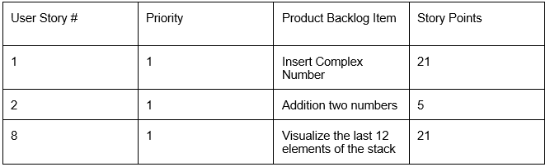
First Sprint Backlog
Goals of the First Sprint
Implementing the following parts of the program:
the graphic interface with a text field where the user can insert numbers and operations and a text area that shows the last 12 elements of the stack
the possibility for the user to insert a complex number on the stack
checking if the inserted input is valid

Slide 10
First Sprint Review
Velocity estimated for the first Sprint: 51
Story Points completed: 62
The team completed all the planned user stories and the following ones:
Bugs discovered and added to the Product Backlog (1 SP):
Bug 1.0: When inserting an input consisting of two imaginary parts
(e.g 5i+4i) instead of giving a «wrong input error» the program adds to the stack a complex number consisting of 0 as real part and the first number as imaginary part (e.g. 0+5i)

Slide 11
Velocity Second Sprint
Total Story Points Remaining: 203
Velocity for the second Sprint: 62 Story Points
1 Story Point = 20 min of work of one developer

Slide 12
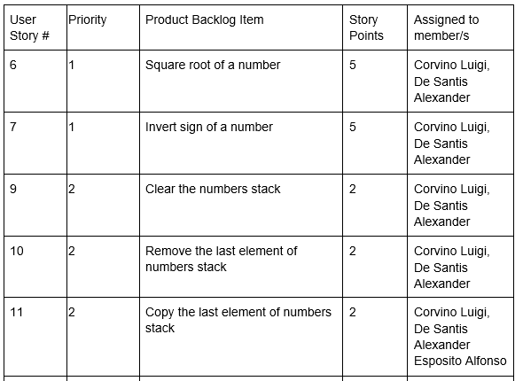
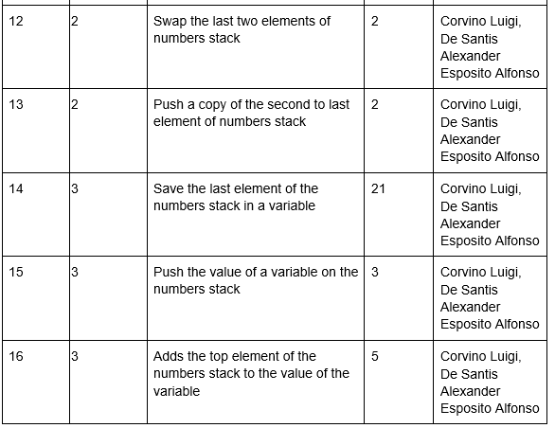
Second Sprint Backlog
Goals of the Second Sprint
Adding the following features to the first sprint release software:
square root and invert sign operations
stack operations
usage of variables
variables operations

Slide 13
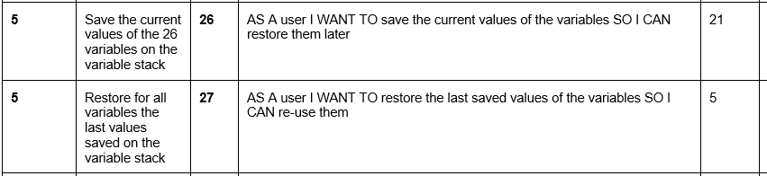
Second Sprint Review
Velocity for the Second Sprint: 62
Story Points completed: 78
The team completed all the planned user stories and the following ones:
Technical Debts discovered and added to the Product Backlog (13 SP)
TD 1.0: We noticed that the method elaborateInput() of the class ProgrammableCalculatorController has become very complex, so it needs a refactoring.

Slide 14
Third Sprint planning
Product Backlog refinements
During the Third Sprint Planning the Team discussed about the design of the upcoming User Stories, and refined the Product Backlog in the following way:
User Stories 18 and 19 were merged together, their individual estimate was of 21 SP and they became a single 21 SP Story
User Story 20’s requested effort was decreased from 34 to 21 SP
With this process the remaining effort of the Project decreased from 138 to 104

Slide 15
Velocity Third Sprint
Total Story Points Remaining: 104
Velocity for the second Sprint: 70 Story Points
1 Story Point = 20 min of work of one developer

Slide 16
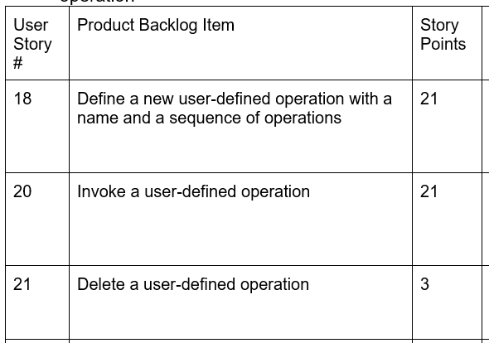
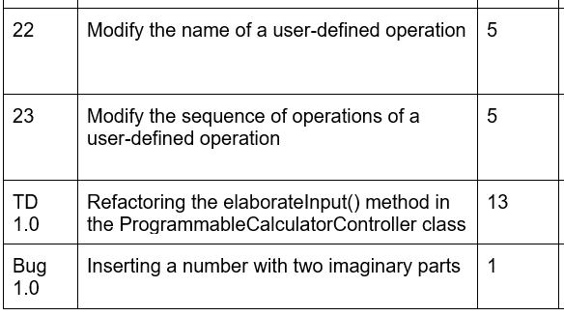
Third Sprint Backlog
Goals of the Third Sprint
Adding the following features to the second sprint release software:
• defining a new user-defined operation
• invoking a user-defined operation
• delete a user-defined operation
• Modifying the name and the sequence of operations of a user-defined operation

Slide 17
Third Sprint Review
Velocity for the Third Sprint: 70
Story Points completed: 68
The team completed all the planned user stories and technical debts/bugs
Technical Debts discovered and added to the Product Backlog (13 and 8 SP respectively)
- TD 2.0: After updating the GUI controls on the user-defined operations we noticed that the “check input methods” got too complex to be updated and mantained, so they need a refactoring.
- TD 3.0: If a user-defined operation fails on an operation in the position i of its sequence, for example because there’s not enough numbers in the stack, the operations from 1 to i-1 still go through. To solve this technical debt we should add an undo method for each operation, so there needs to be a refactoring on the Operation Classes.

Slide 18
Remaining effort and final velocity
Total Story Points Remaining: 57
Average velocity of the Team after 3 Sprints: 69 Story Points
1 Story Point = 20 min of work of one developer

Slide 19
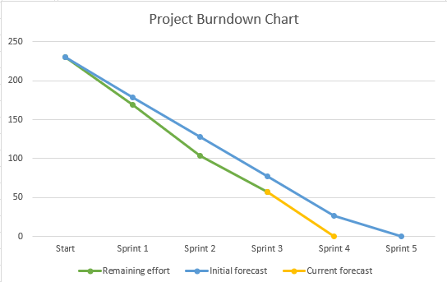
Project Burndown Chart

